Slide 1
Analysis on Wine Dataset for wine classification
Prepared By: Manisha Khatri
Under the guidance of:
Dr. Vineetha Menon
CS588:Intro to Big Data Computing

Slide 2
Agenda:
Introduction
Dataset Description
Data visualization
Data preprocessing
Discussion of methods
Results and analysis
Conclusion

Slide 3
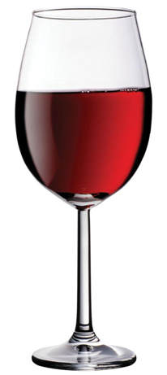
Introduction
AM I
Worth
It?
There are more than a 1000 varieties
A million reviews
And guess what, they are pricy too!
How do we choose?
Big data to rescue!

Slide 4
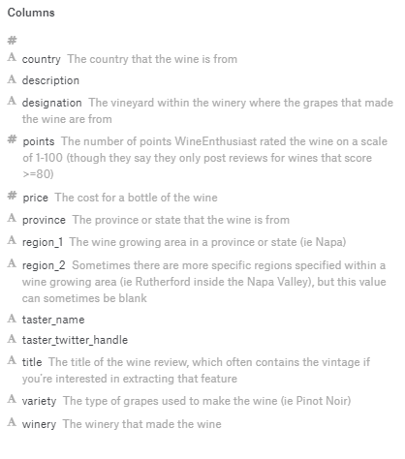
Dataset Description
Features
Description
Points
country
variety
title
Preprocessing
Source:-Wine Reviews https://www.kaggle.com/zynicide/wine-reviews

Slide 5
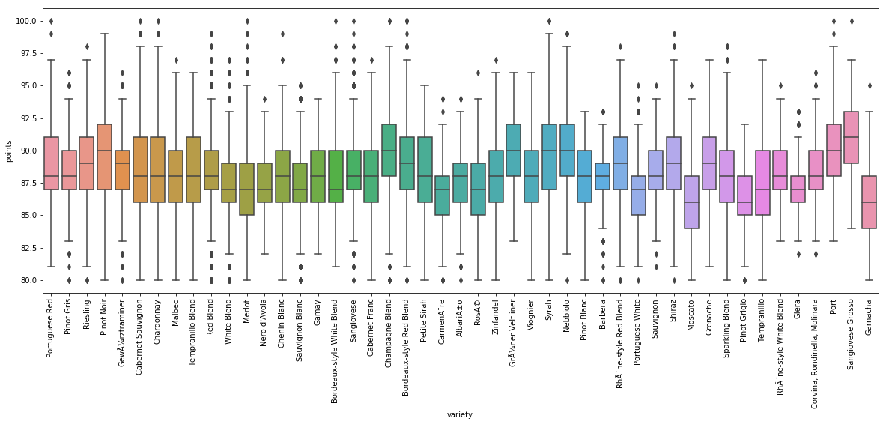
Data Visualizations
Variety Vs Points

Slide 6
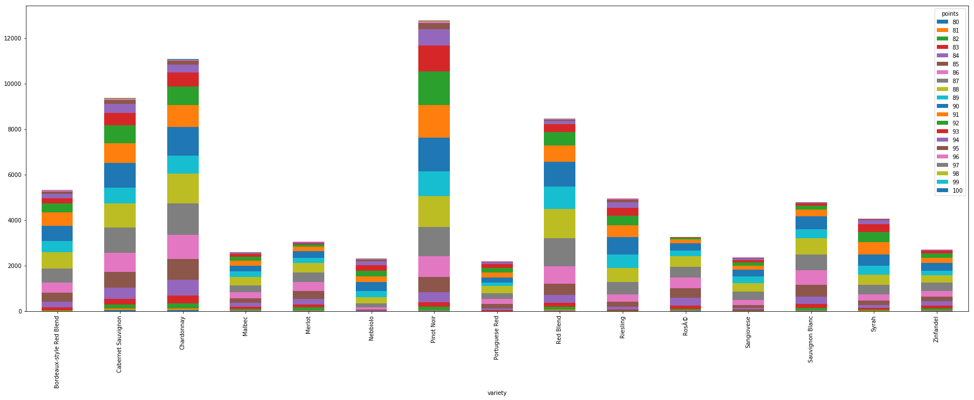
Data Visualizations
Variety Vs Points

Slide 7
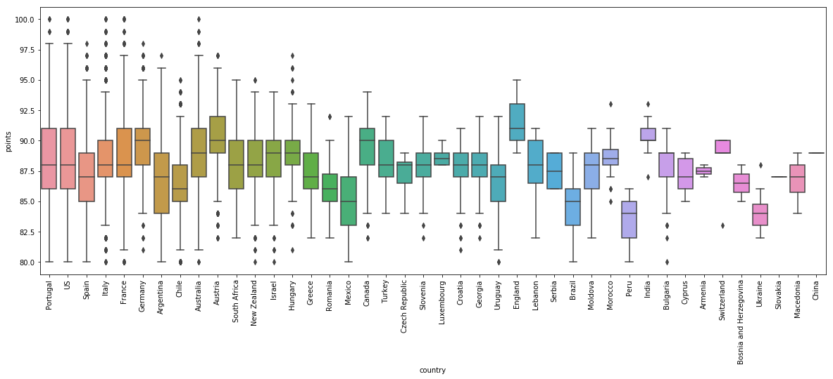
Data Visualizations
Country Vs Points

Slide 8
Data Preprocessing
Why?
Real-world data can have missing values for important attributes, contain outliers or invalid data that can skew the results
Make it compatible for big data processing
Steps :
Remove missing/duplicate values
Remove records with special characters
The countries with more than 3764 records and varieties with more than 5000 are considered
Create 4 class labels from points(“Bad”, “Good”, “Better”, “Best”)
Vectorize textual data

Slide 9
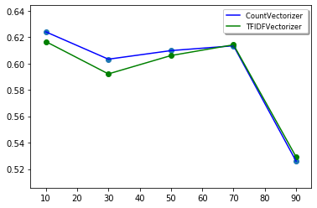
Countvectorizer Vs TFIDFVectorizer
Countvectorizer: a simple way to both tokenize a collection of text documents and build a vocabulary of known words, but also to encode new documents using that vocabulary It counts the word frequencies in a document
TFIDFVectorizer: The value increases proportionally to count, but is offset by the frequency of the word in the corpus

Slide 10
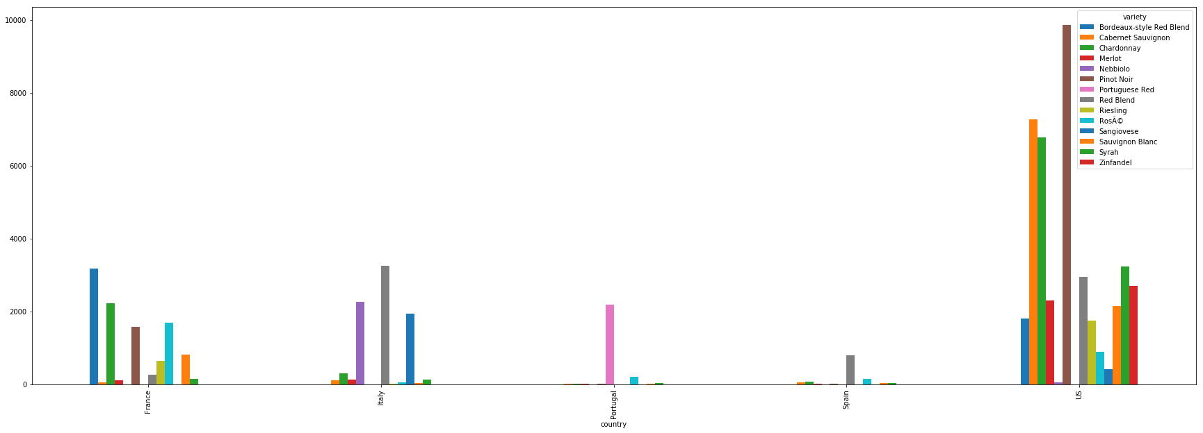
Data Visualization
Country Vs Variety

Slide 11
Discussion of methods
Dimensionality reduction:
PCA: Find the directions of maximum variance in high-dimensional data and projects it onto a new subspace with equal or fewer dimensions than the original one
LDA: It finds a new feature space to project the data in order to maximize class separability and minimizes inter-class variability

Slide 12
Discussion of methods
Classification Algorithms:
K-Nearest Neighbor: KNN (K-Nearest Neighbor) is a simple supervised classification algorithm that implements the k-nearest neighbors vote
Support Vector machines: The objective of the support vector machine algorithm is to find a hyperplane in an N-dimensional space(N — the number of features) that distinctly classifies the data points.
Naive Bayes classification: It predicts the probability of each class based on the feature vector for text classification for continuous big data with a prior distribution of the probability

Slide 13
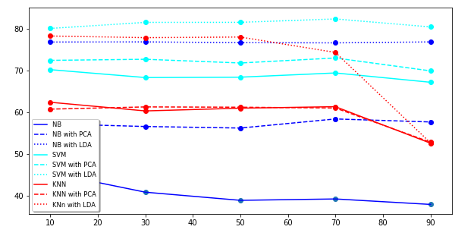
Results and analysis
PCA: Explained variance ratio (first two components):- 9.91225863e-01, 7.93060405e-04

Slide 14
Conclusion
Better performance after dimensionality reduction
Performances are comparable for Naive bayes and KNN
SVM gives the highest accuracy of classification of wine

Slide 15

Now You can sit and enjoy while Big data finds the best wine for you!! Cheers☺

